Slide 1


Robotics II Project
Short Preview Optimization Approach to Minimize The (Inverse Inertia Weighted) Norm of The Joint Torque
Faculty of Information Engineering, Informatics, and Statistics
Department of Computer, Control, and Management Engineering “Antonio Ruberti”
Master’s Degree in Artificial Intelligence and Robotics
Alessio Ragno
Dylan Savoia

Slide 2
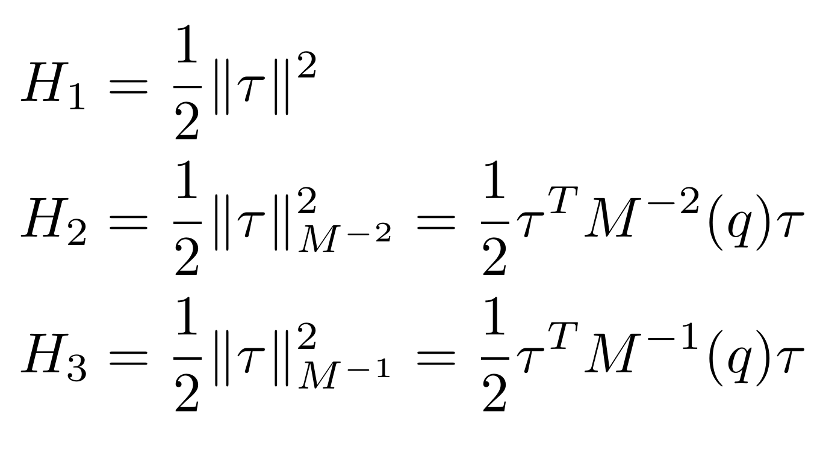
Introduction: Torque Norm Minimization
We can achieve torque norm minimization, optimizing different targets (depending on the weighting)
MTN
MTSIWN
MTIWN

Slide 3
Introduction: Redundant Robots
If the number of DOF of the robot (n) is bigger than the number of task constraints (m) the robot is redundant with respect to the task The redundancy can be exploited to solve additional constraints like locally minimizing the torque norm projecting the desired behavior in the Null Space of the solution (to not affect the main task)

Slide 4
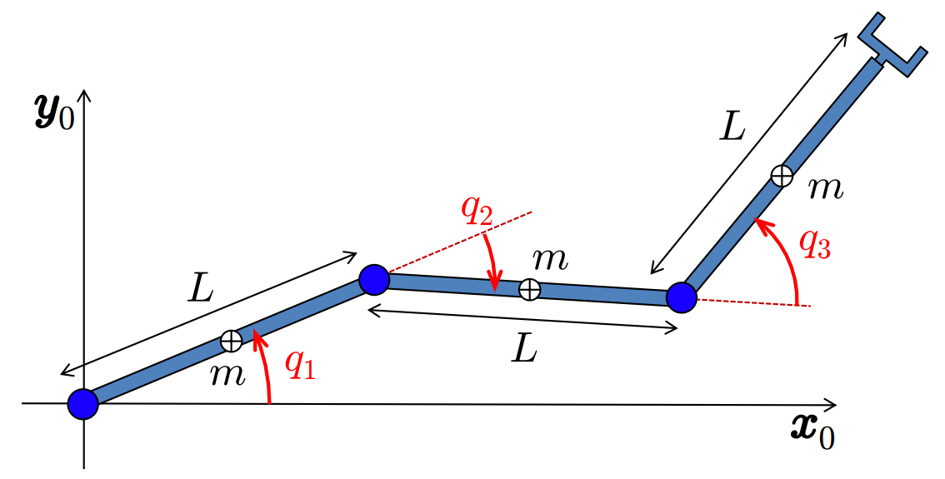
Introduction: Robot
We deal with a 3R planar robot placed on a horizontal plane, which allows us to neglect the effect of gravity.
link mass (m = 10kg) uniformly distributed
link length L = 1m
moment of inertia I_{L} = ml²/12
relative joints positions (DH notation)

Slide 5
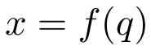
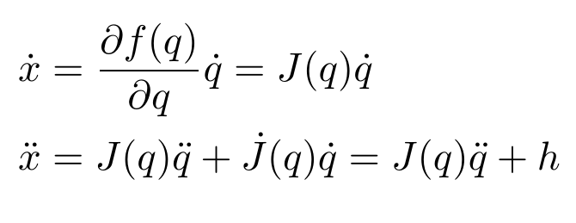
Introduction: Task Details
We want to perform a bang-bang profile on a linear path on a Cartesian plane (degree of redundancy n - m = 1)
Two versions of the task:
long: 1.1738 m
short: 0.2828 m
Given the task kinematics we define the first- and second- order differential relations

Slide 6
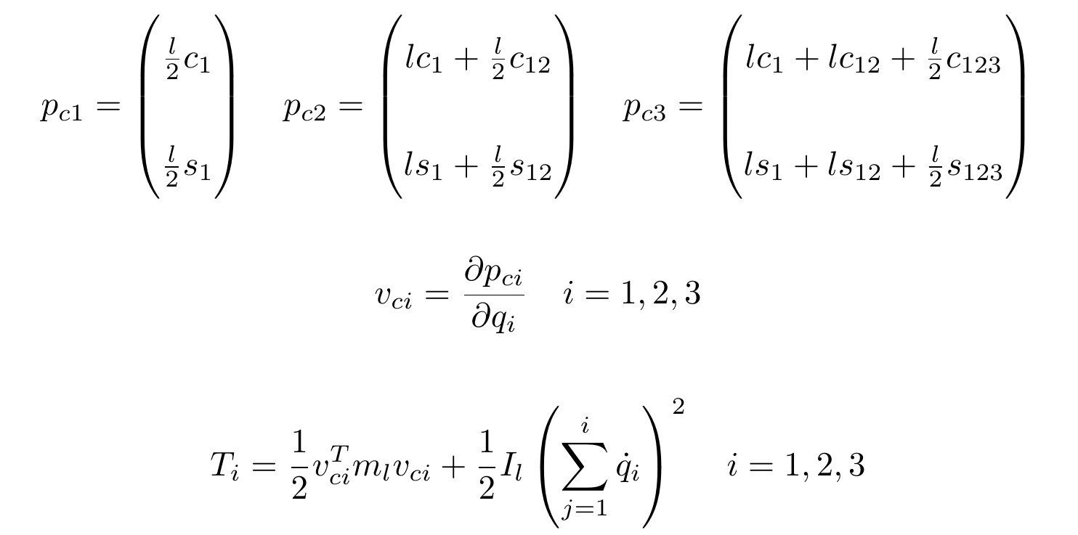
Robot Model

Slide 7
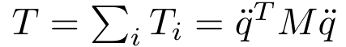
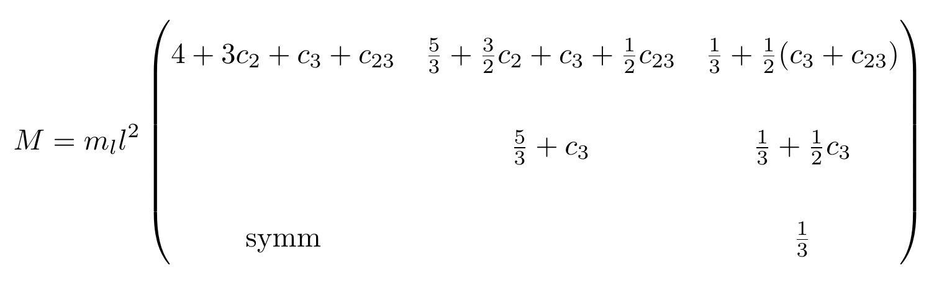
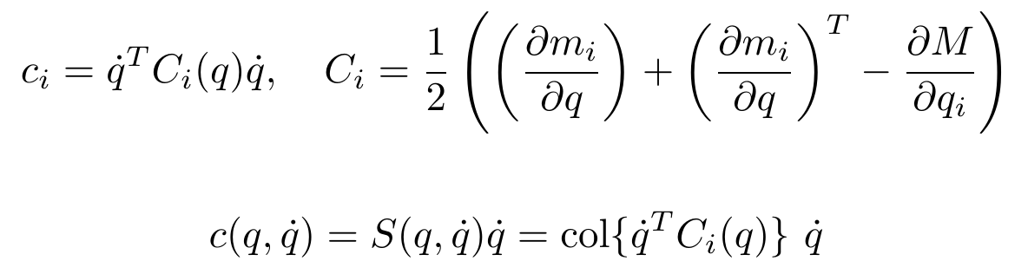
Robot Model (contd.)
Given that

Slide 8
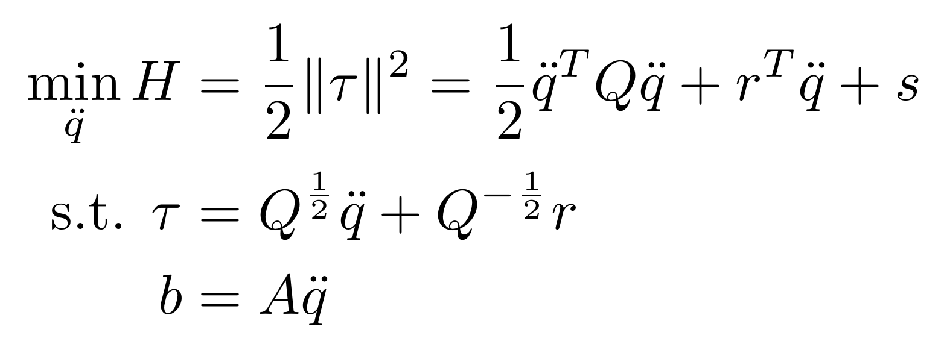
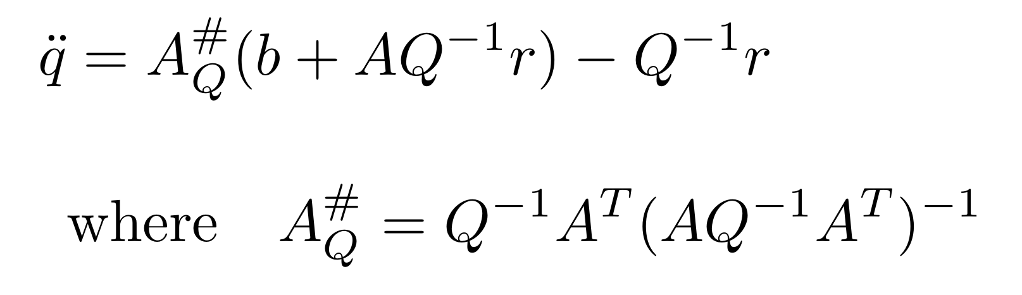
General Minimum Torque Norm Solution
The problem can be defined as a standard linear-quadratic optimization
with the following unique solution

Slide 9
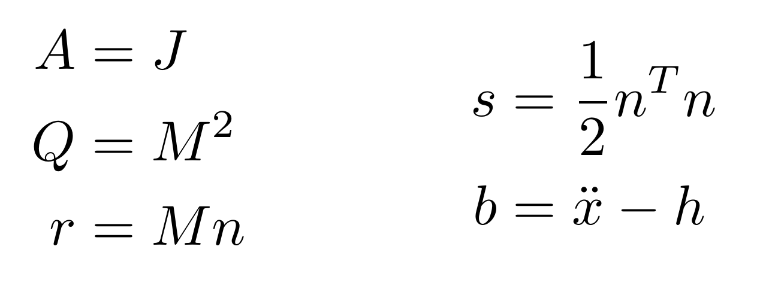
Minimum Torque Norm Optimization (MTN)
We can perform the following substitutions to the general solution to minimize the torque norm
To reduce tracking error during motion, a stabilizing PD feedback control term is inserted at the task level in b

Slide 10
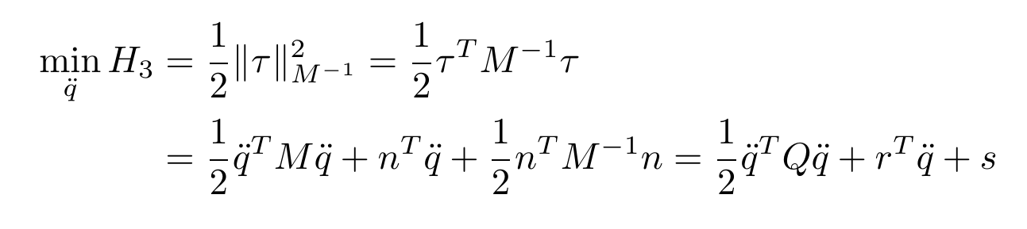
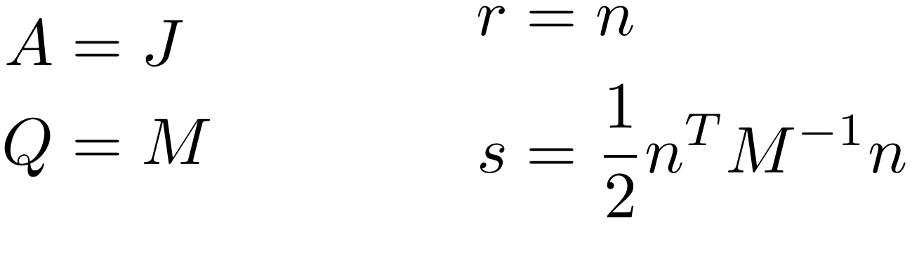
Minimum Inverse Inertia Torque Norm (MTIWN)
Use the same approach to minimize the Inverse Weighted Torque Norm:
which has the form of the general solution, applying the following substitutions:

Slide 11
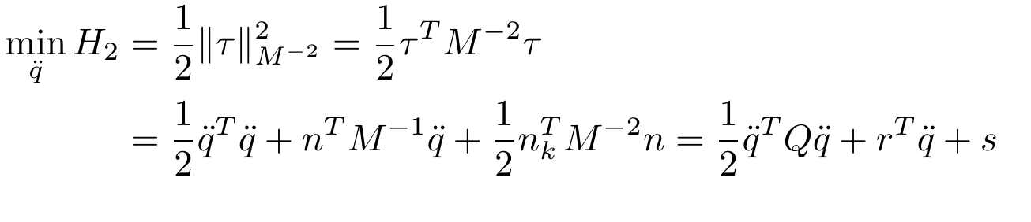
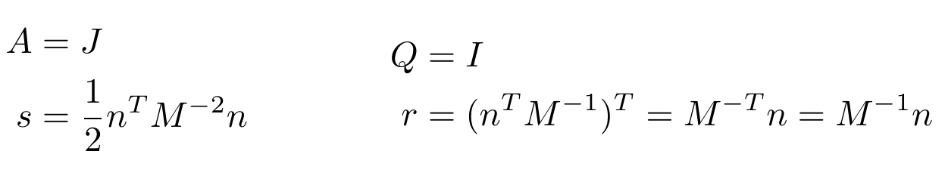
Min. Squared Inv. Inertia Torque Norm (MTSIWN)
And finally do the same for the Squared Inverse Weighted Torque Norm:
which has the form of the general solution, applying the following substitutions:

Slide 12
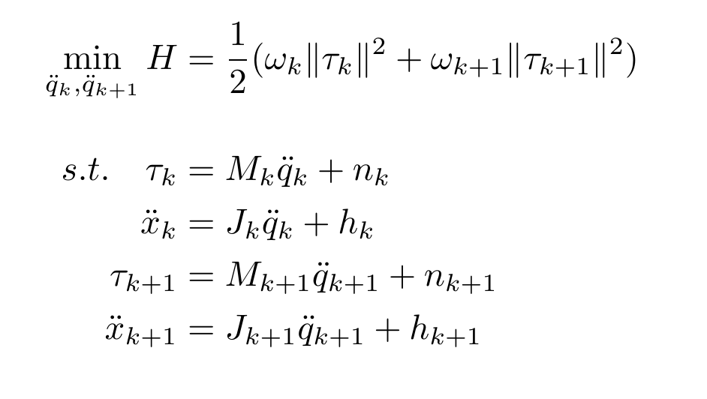
Short Preview Method
To prevent long term unstable behavior: include an estimation of the future robot state during the optimization process (Short Preview¹). The method leads to the following optimization problem:
K. Al Khudir, G. Halvorsen, L. Lanari, and A. De Luca. Stable torque optimization for redundant robots using a short preview. IEEE Robotics and Automation Letters, 4(2):2046–2053, 2019.

Slide 13
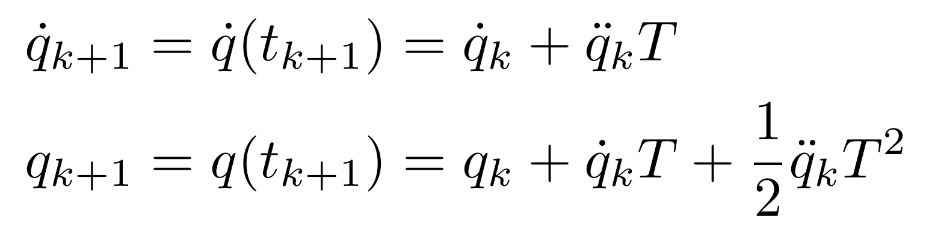
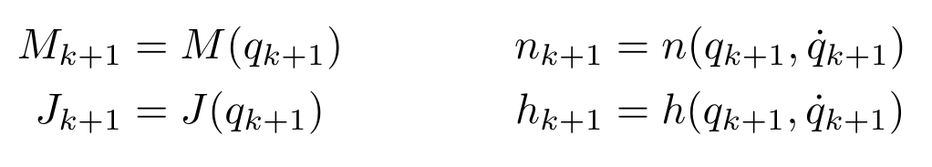
Short Preview Method (contd.)
Some useful notation….

Slide 14
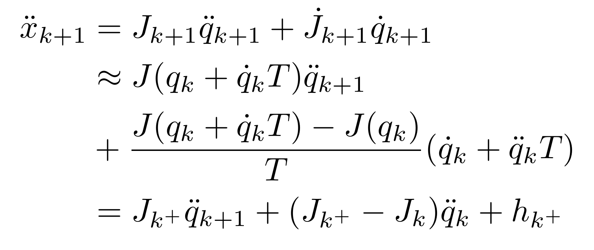
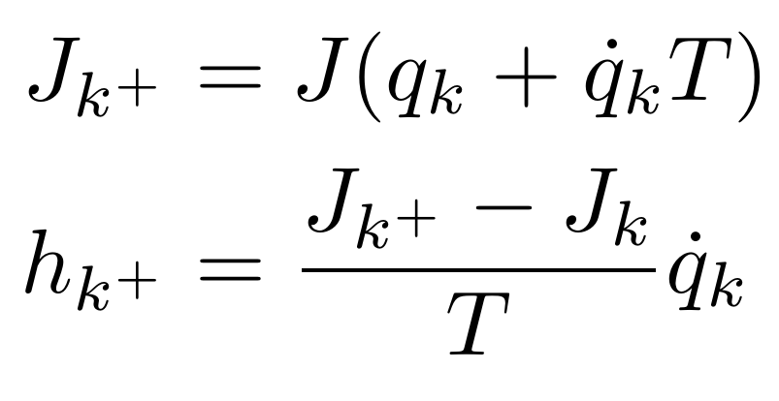
Short Preview Method (contd.)
The problem becomes nonlinear in the joint acceleration. This requires to apply the following approximations:
where

Slide 15
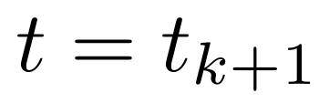
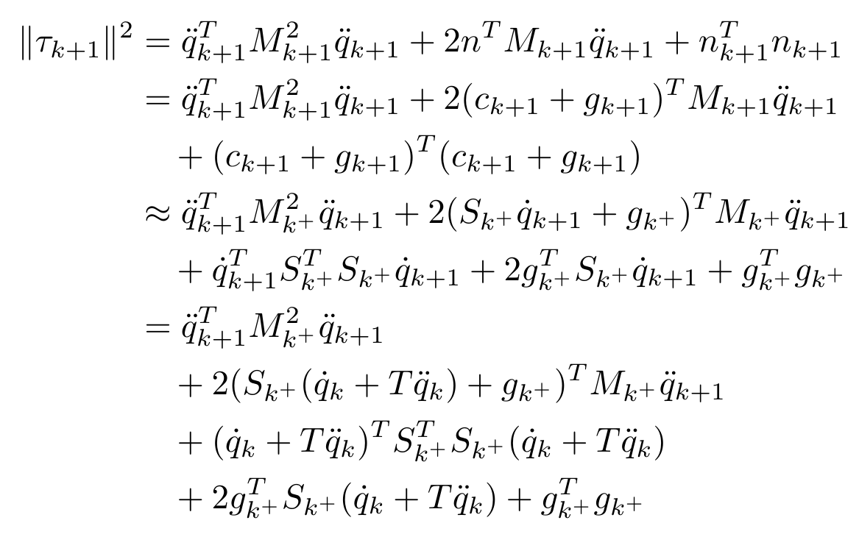
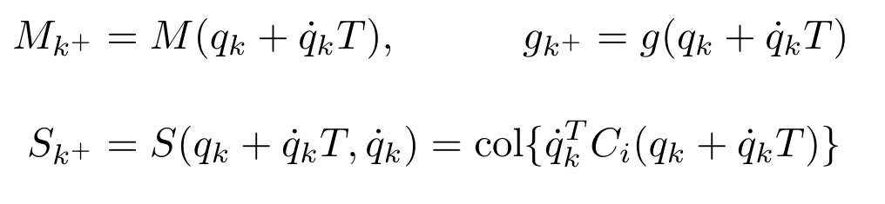
Short Preview Method (contd.)
We can rewrite the torque norm at time step
where

Slide 16
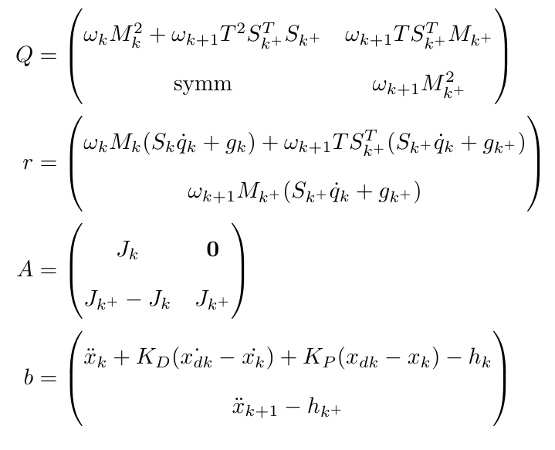
Short Preview: Model Based Preview (MBP)
The problem can now be expressed in the general solution form with the following substitutions:

Slide 17
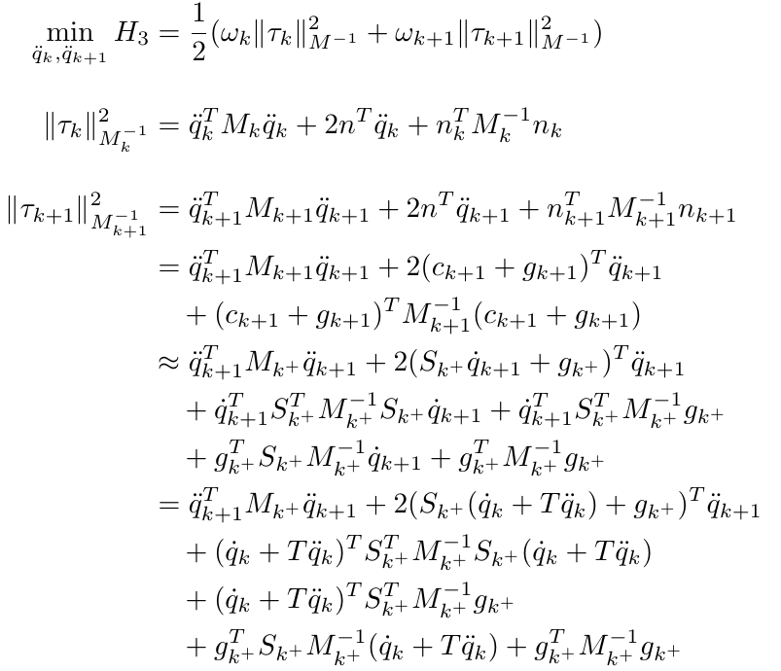
Model Based Inv. Inertia Weighted Preview (MBIWP)
We use the same approach to minimize the Inverse Weighted Torque Norm with the Short Preview method:

Slide 18
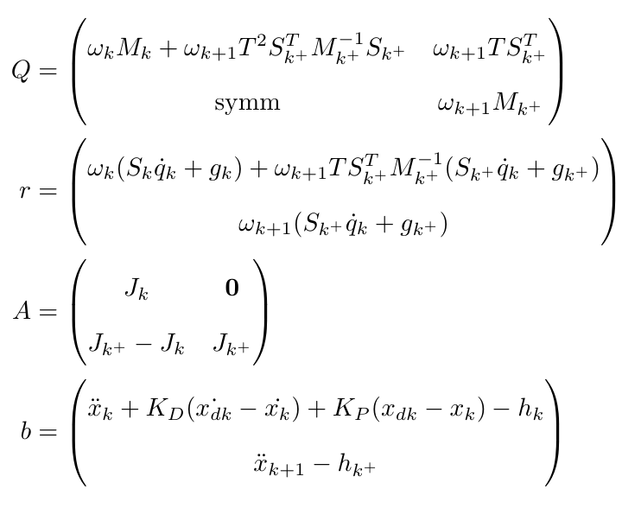
Model Based Inv. Inertia Weighted Preview (MBIWP)
where the substitutions in the general solution now become:

Slide 19
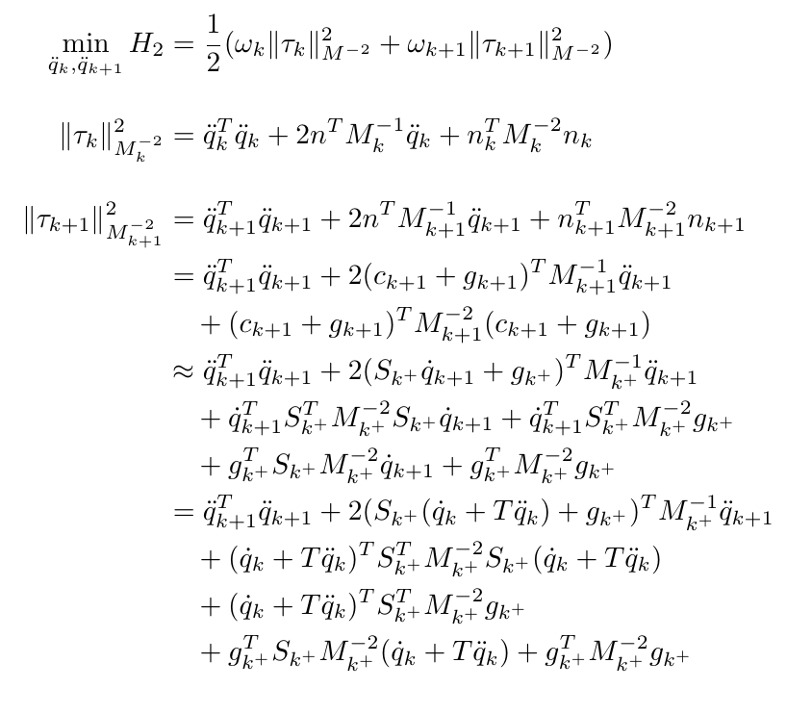
MB Squared Inv. Inertia Weighted Preview (MBSIWP)
Finally we do the same for the Squared Inv. Inertia Weighted Torque Norm for which the problem can be expressed as:

Slide 20
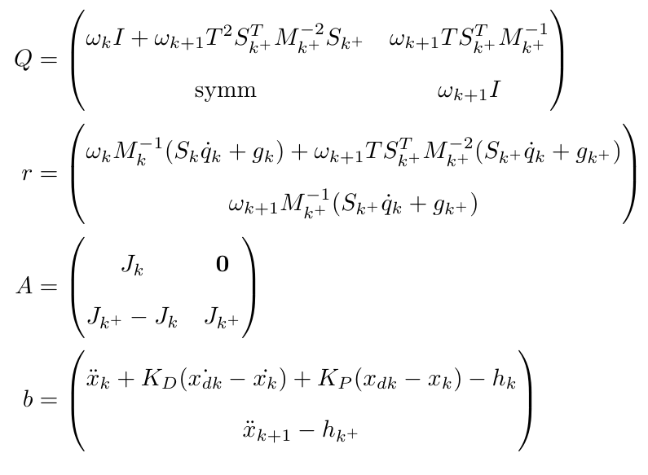
MB Squared Inv. Inertia Weighted Preview (MBSIWP)
We adapt the general solution with these substitutions:

Slide 21
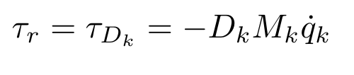
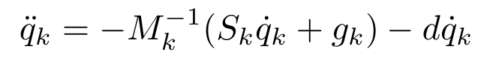
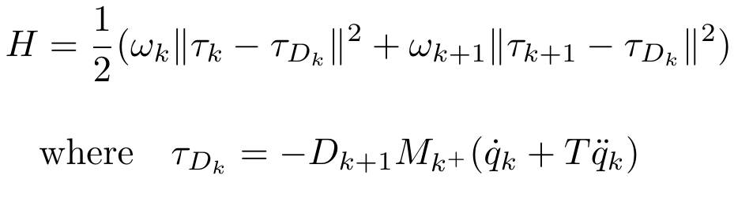
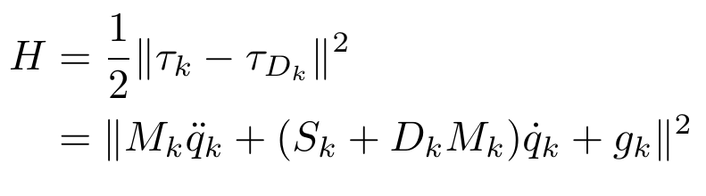
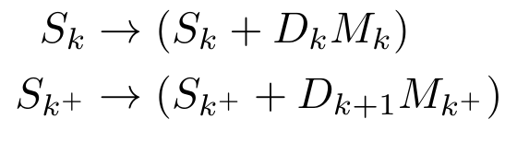
Damping In The Null-Space
To reduce joint-motion oscillation we minimize the difference between the torque and a given reference:
Target Torque
Resulting Joint acceleration (assuming D_{k} = dI > 0)
Minimization Problem
Minimization Problem with Preview Window
Final substitutions in r and Q needed for the damping.

Slide 22
Results: Experimental Setup
Results are obtained with the same settings of the original paper:
T_{s} = 0.001 s
D_{k} = 10 I
K_{P} = 10 I
K_{D} = I
p = 100 → T = 100 T_{s} = 0.1 s
A = 1.4142 m/s²

Slide 23
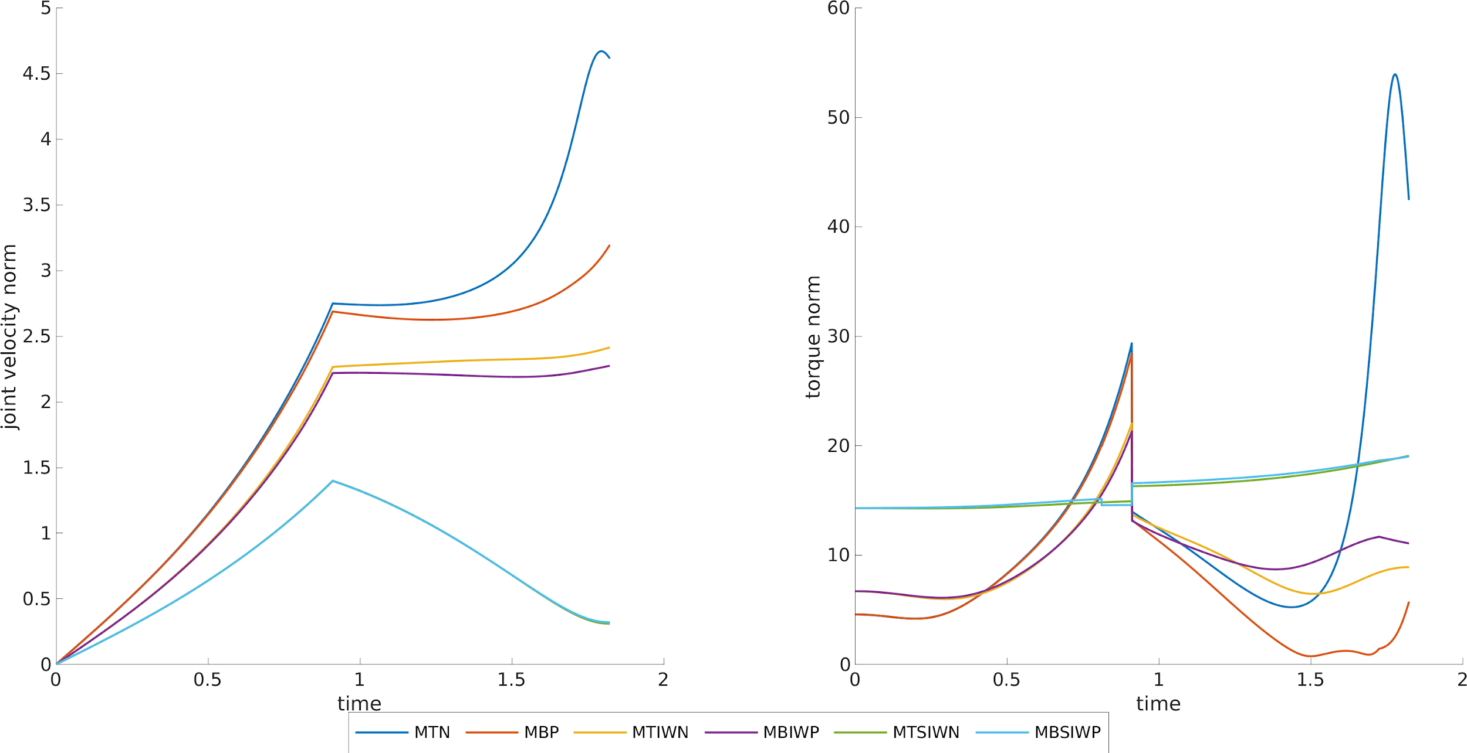
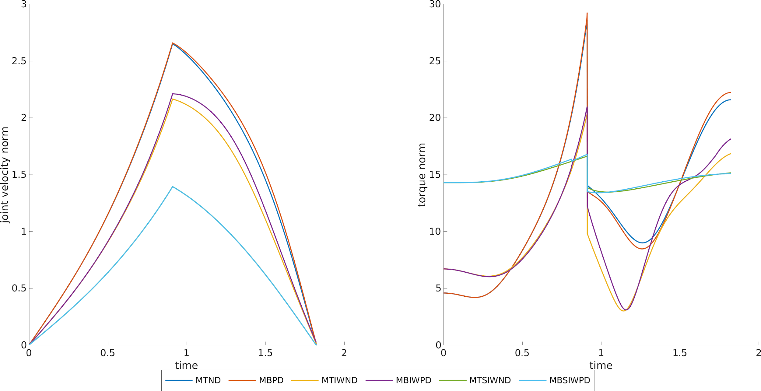
Results: Long Path - Velocity and Torque Norm

Slide 24
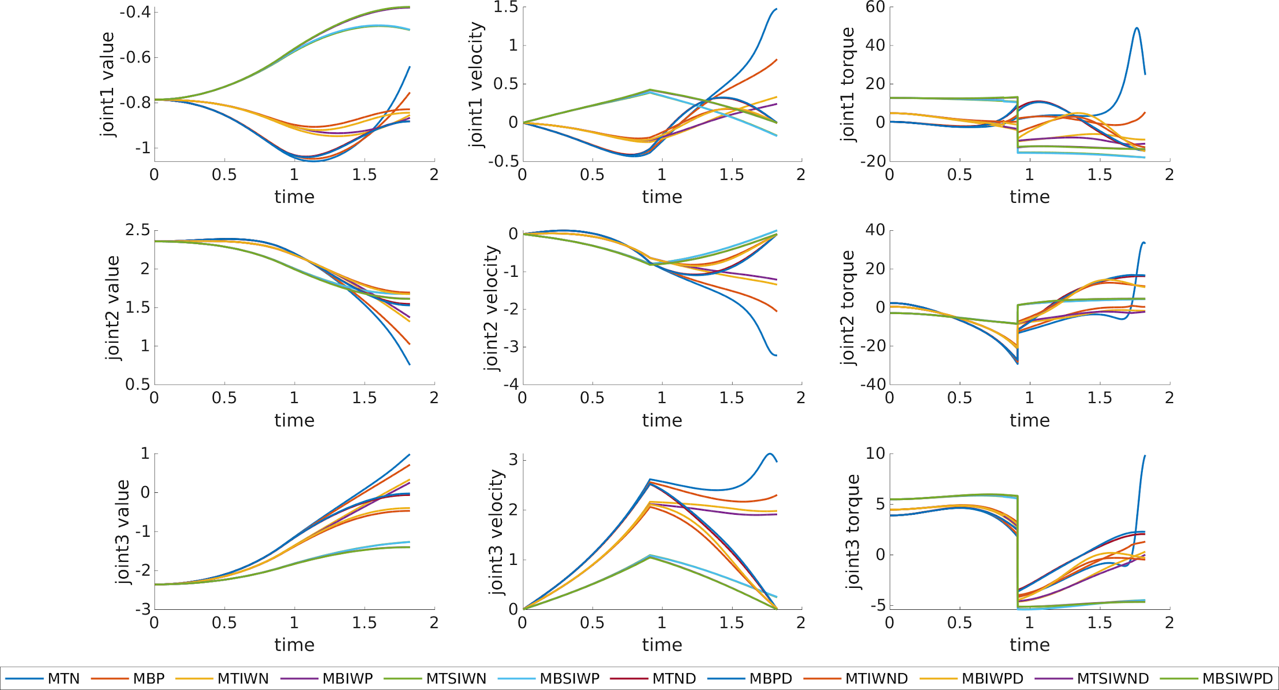
Results: Long Path - Joint Profiles
Only for general differences in behavior. Cannot pinpoint specific methods.

Slide 25
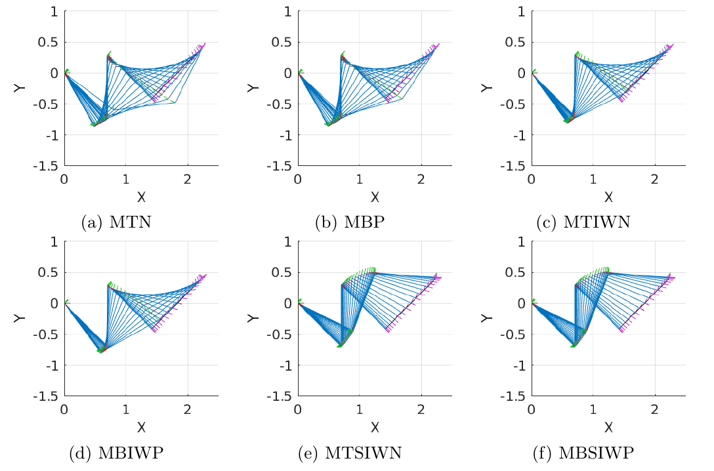
Results: Long Path - Motions

Slide 26
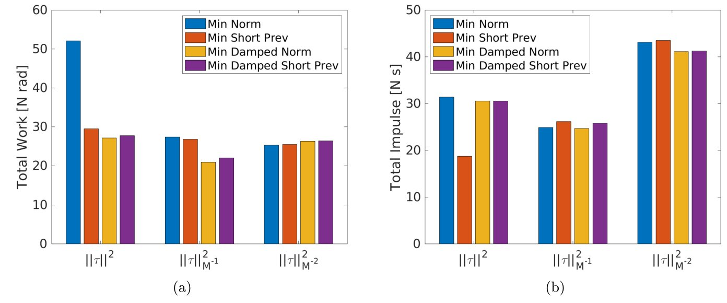
Results: Long Path - Work & Impulse

Slide 27
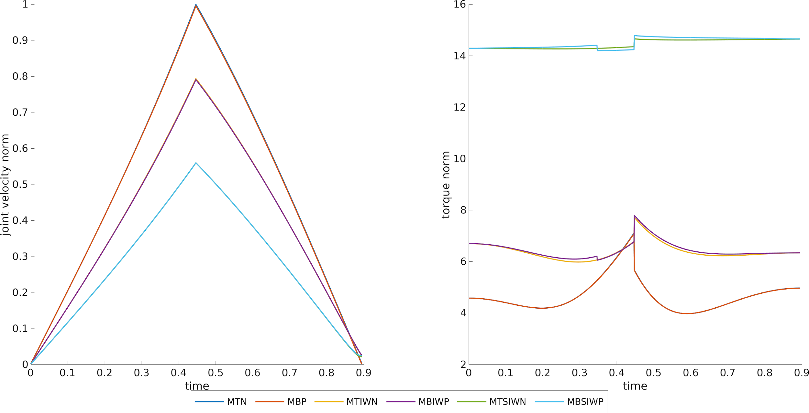
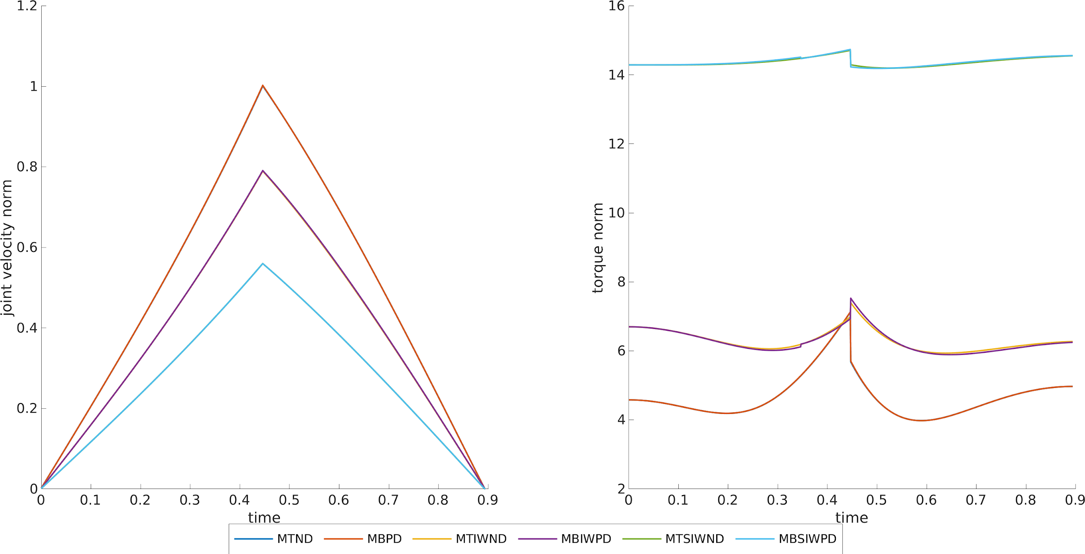
Results: Short Path - Velocity and Torque Norm

Slide 28
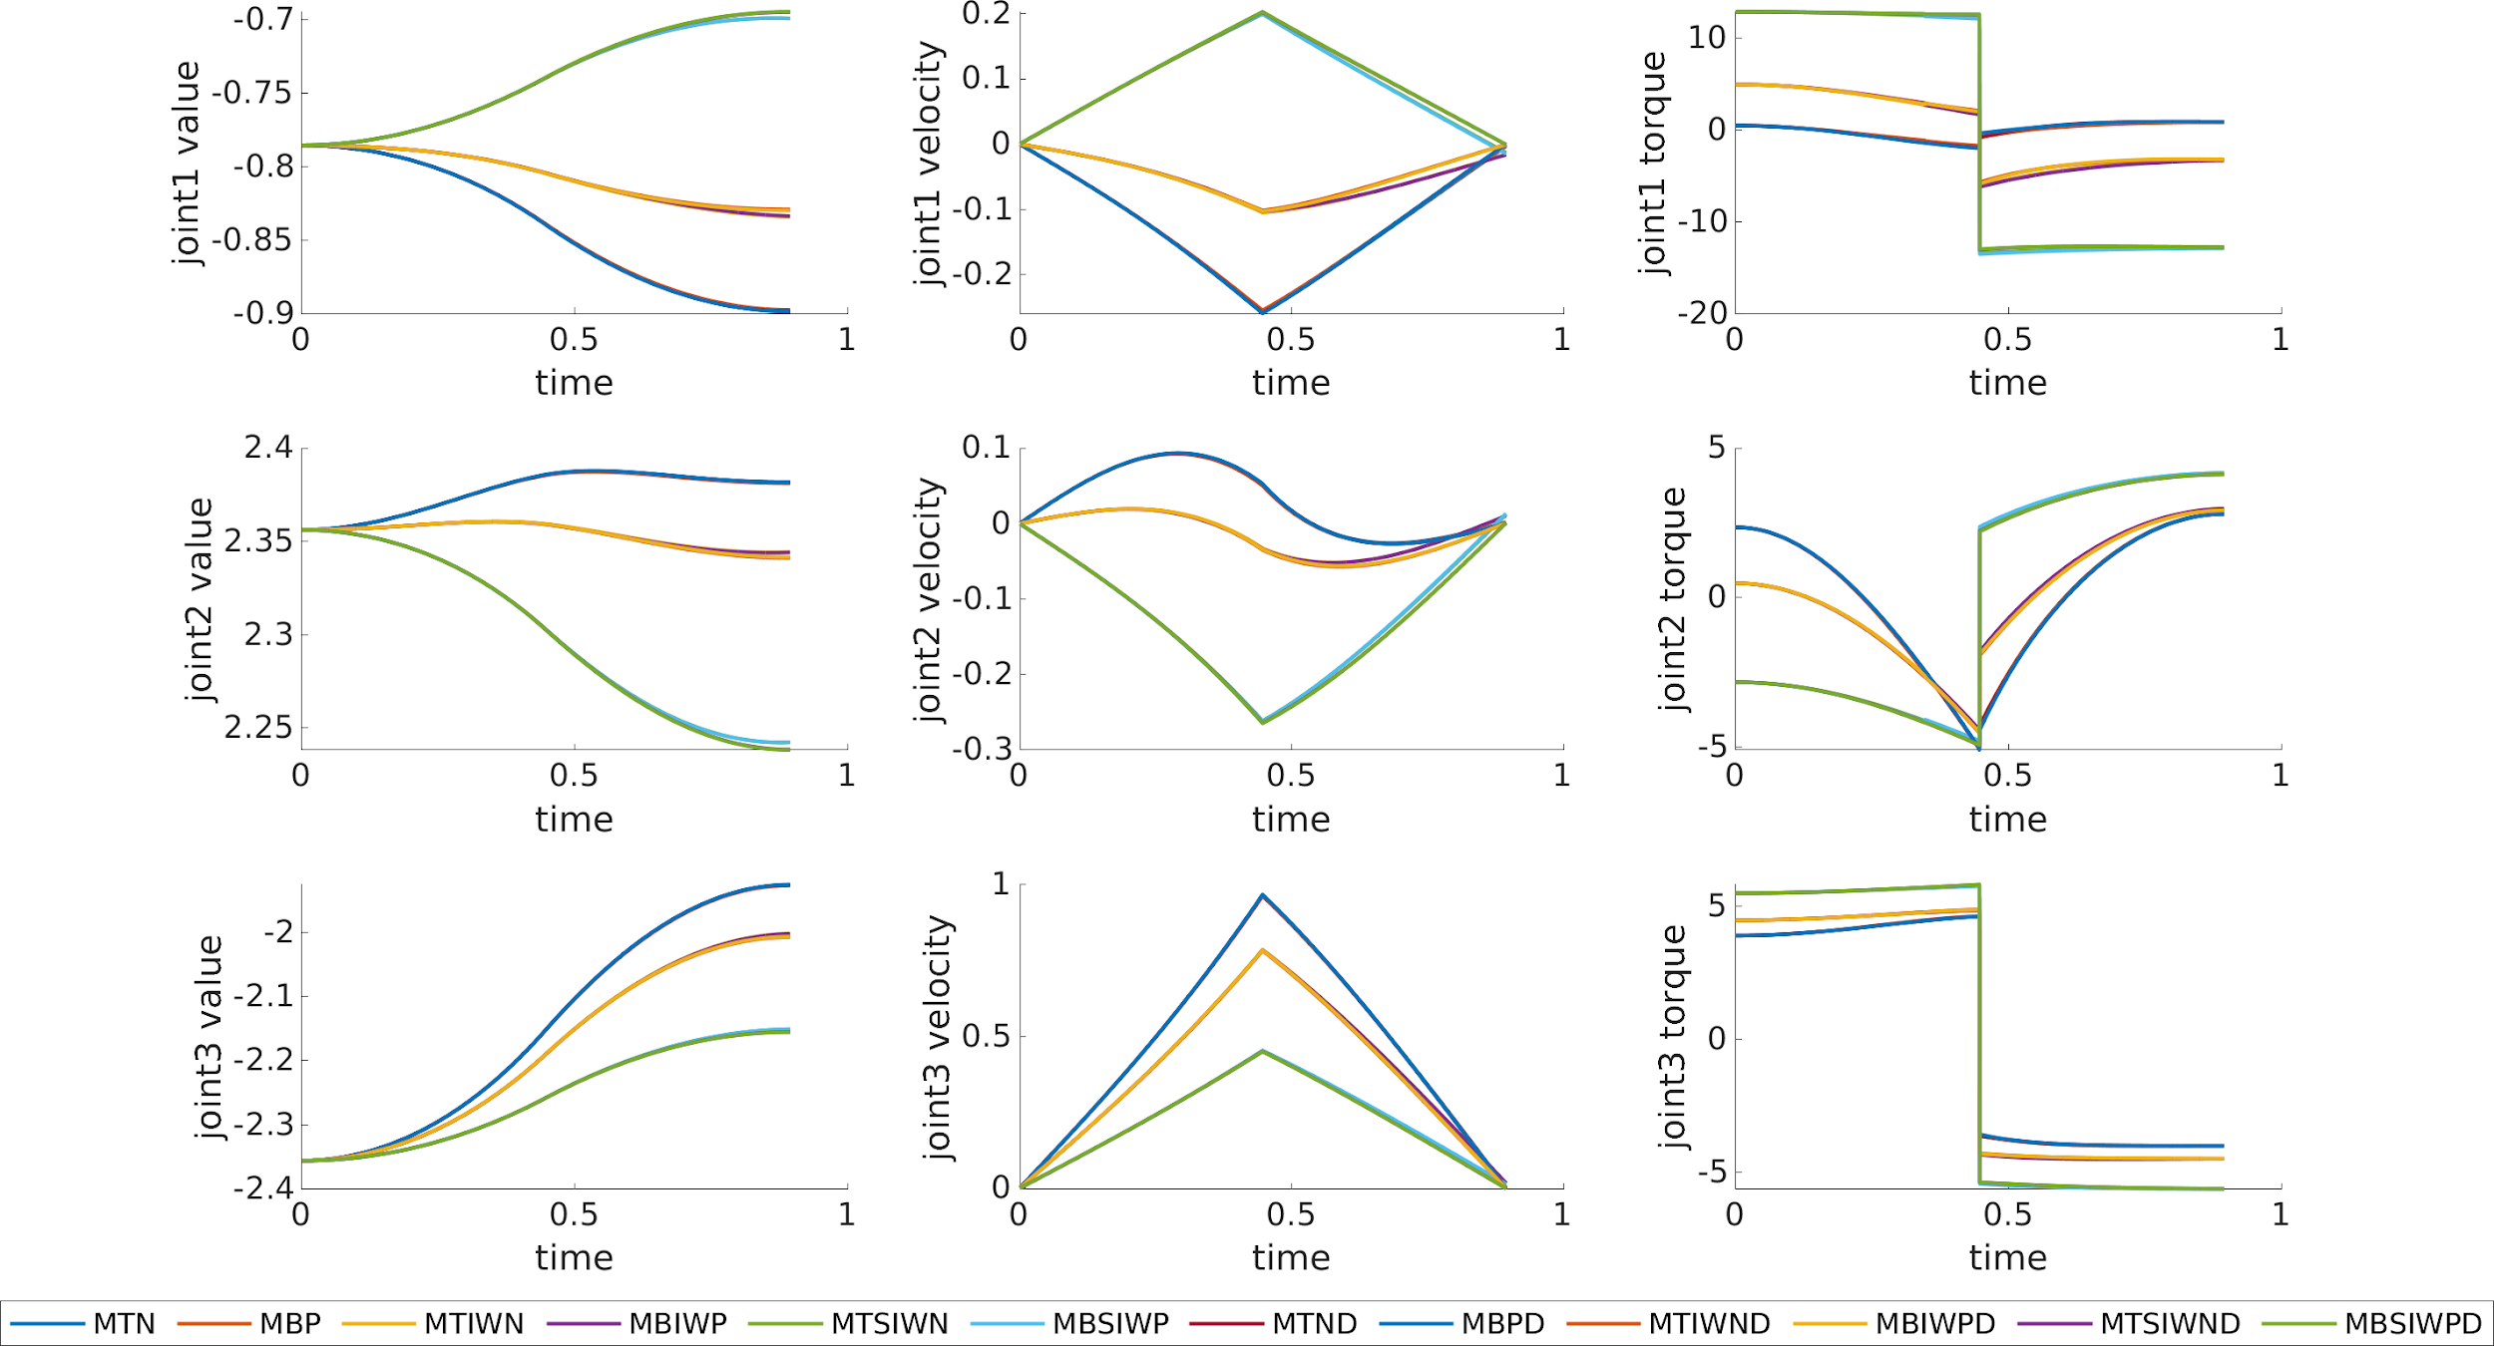
Results: Short Path - Joint Profiles
Only for general differences in behavior. Cannot pinpoint specific methods.

Slide 29
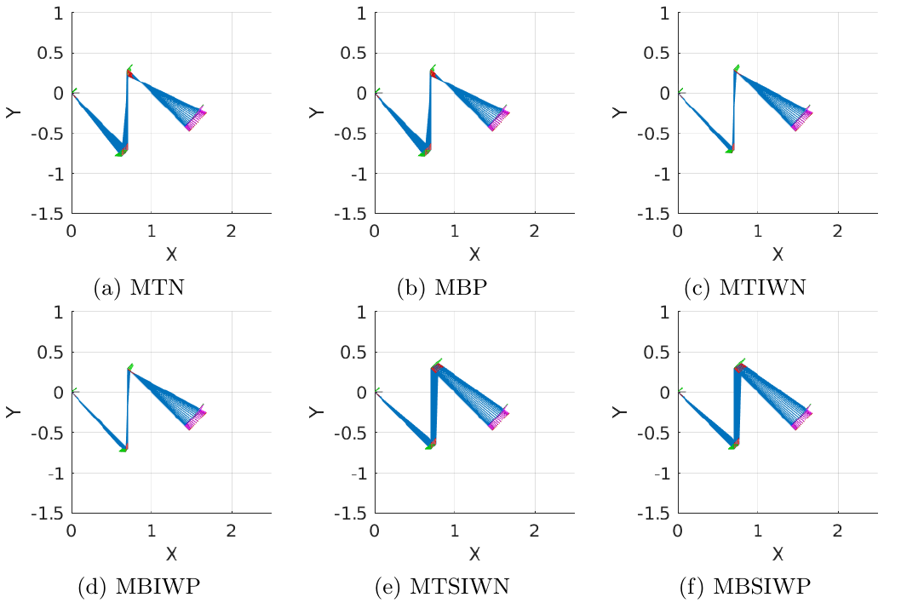
Results: Short Path - Motions

Slide 30
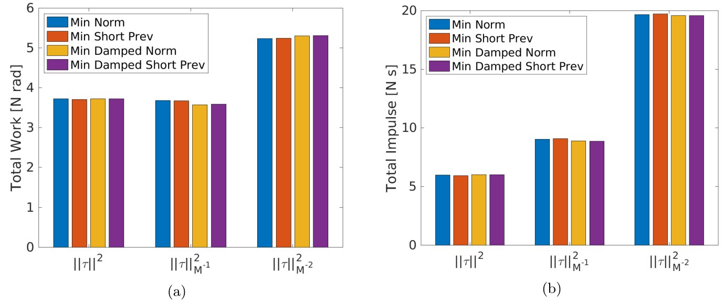
Results: Short Path - Work & Impulse

Slide 31
Conclusions
The tasks we experimented on, may be too simple to evaluate more complex behavior that can arise from the application of the different methods.
Minimizing the torque, taking into account the estimation of the future state of the robot, can lead to a smoother motion.
We see that using the damping and a weighted torque norm already results in a less sharp motion.

Slide 32

Future Work
Using an adaptive time window might further help the effectiveness of the estimation, specifically by choosing a smaller window when possible in order to not approximate more than necessary.
On the other hand, a tiny window may not be helpful as it would simply degenerate to the vanilla approach.
We assume there is a function of velocity and acceleration that can optimally predict the
best value for the preview-window
size (p), hence it may be possible
to train a RL agent, to approximate
that function.

